Slide 1
Robot Design
Team: @Rising Stars
Team No : 66782
Lego League 2025
Theme: Unearthed
f
Notes:
Ria

Slide 2
Team Members
Name Age
Riona Panda 10
Zoey Jain 11
Shaivi Aggarwal 11
Saanvi Loomba 11
Saumya Loomba 11
Girisha Gupta 11
Riya Patil 12
Notes:
Riya
Good Morning Judges, We are

Slide 3
Mission Strategy
Took mission board print out and marked on those sheets to find missions and path required.
Tried missions with hand.
Tried individual missions first and then combined them to optimize runs and time.
Tried various combinations to maximize score.
Picked ones that can be completed in 2.5 minutes and gives maximum score.
Notes:
Zoey

Slide 4
Resources Used
Spike Prime Lessons
Online FLL Tutorials
Online research
Team Coaches
Talked to other team coach
Lego Studio 2.0
Lego robot design and team guides
Notes:
Zoey

Slide 5
Skill building
Did basic programs to move straight, turn, use sensors and motors
Created Pseudo code with paper and pencils
Shared and improved
Distributed work in two groups to get things done faster
Learned coding with Gyro to improve accuracy
Created reusable code blocks for different missions
Notes:
Shaivi

Slide 6
Sample Routines developed

Slide 7
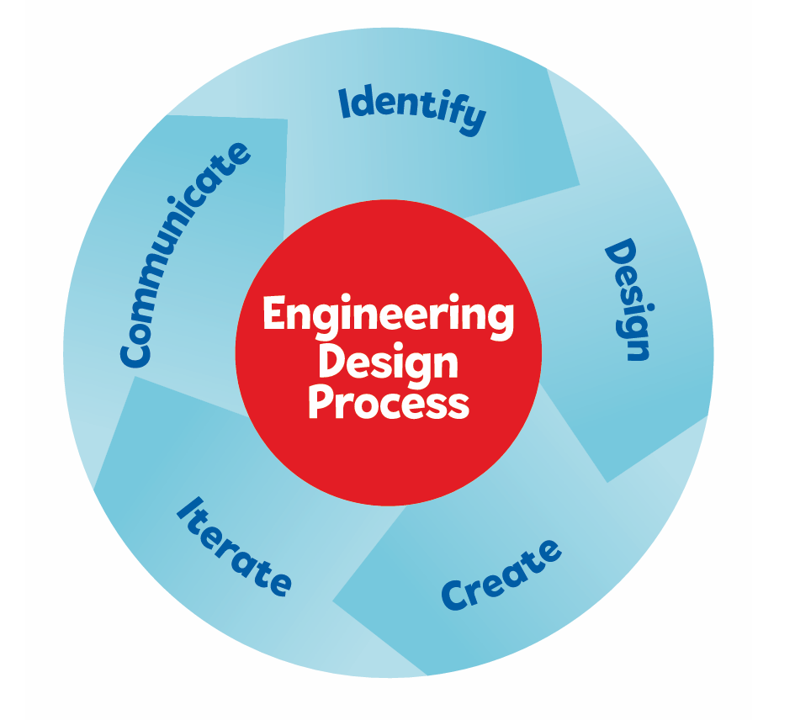
Engineering Design Process
Notes:
Shaivi

Slide 8
Robot Design
Reviewed mission board and various missions
Tried 3 different designs before picking final version.
Used Engineering Design process to iterate and improve.
Combined learnings from last season and 3 earlier designs to design selected design.
Tried many runs to make small incremental improvements.
Notes:
Saanvi

Slide 9
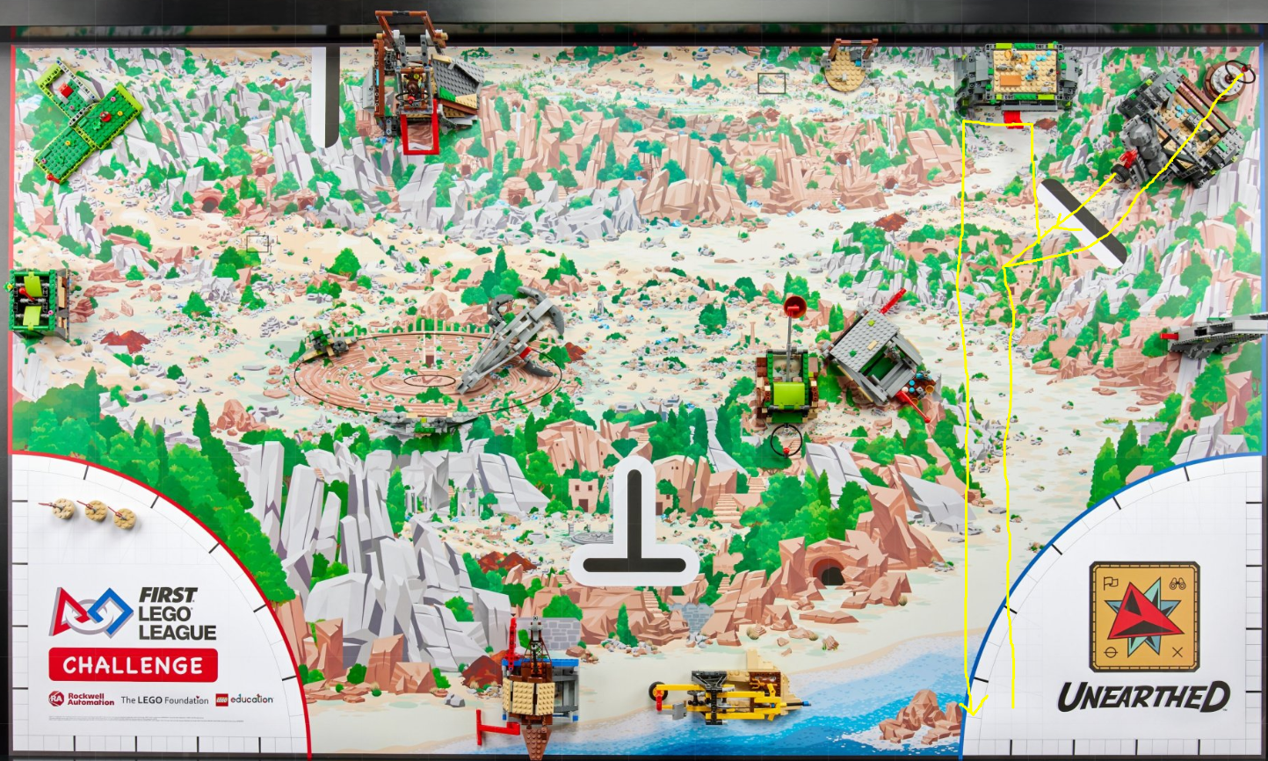
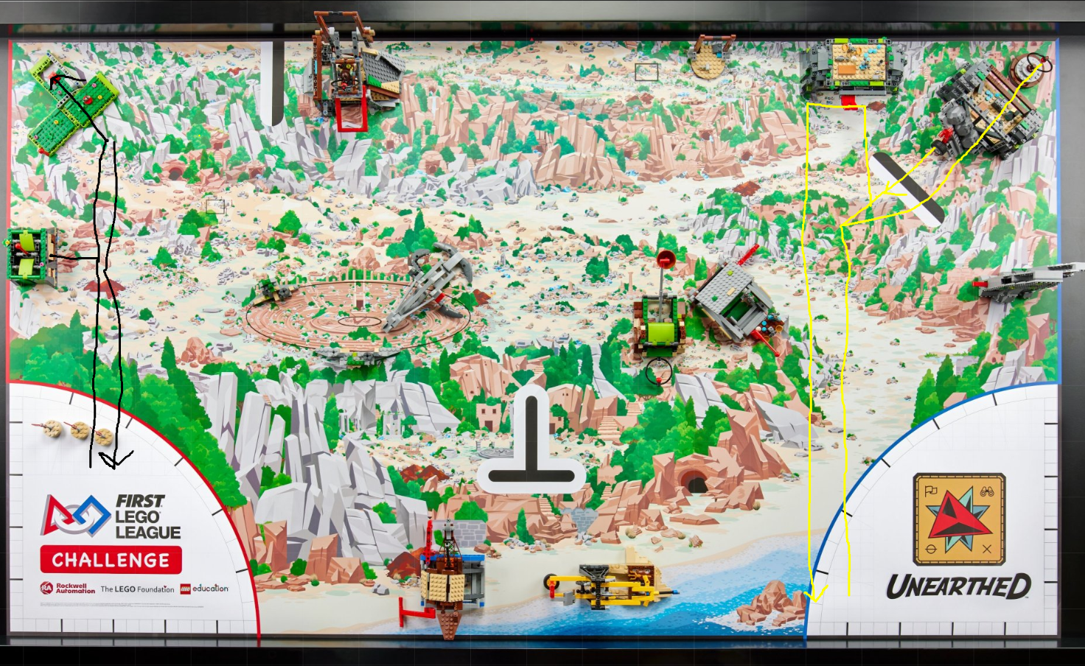
Mission Strategy

Slide 10
Robot Design
Box design with flat surfaces on all sides for easy and modular attachments
4 Motors
2 for Wheels
2 for attachments
More powerful motors for attachments
2 rubber wheels to reduce slips and more accuracy
1 caster wheels with steel ball
Charge port accessible
2 Color sensors
Notes:
Saanvi

Slide 11
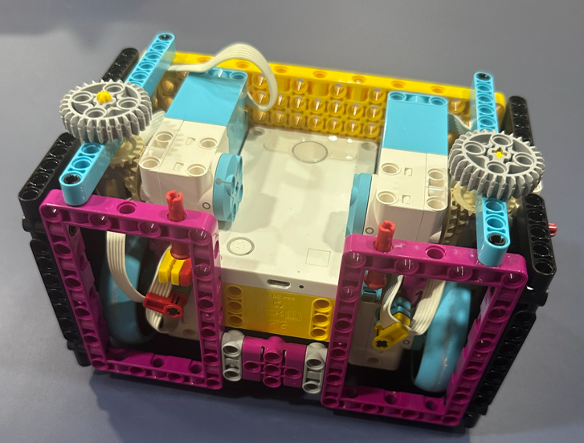
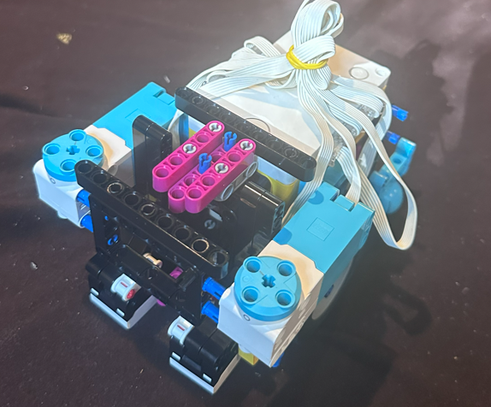
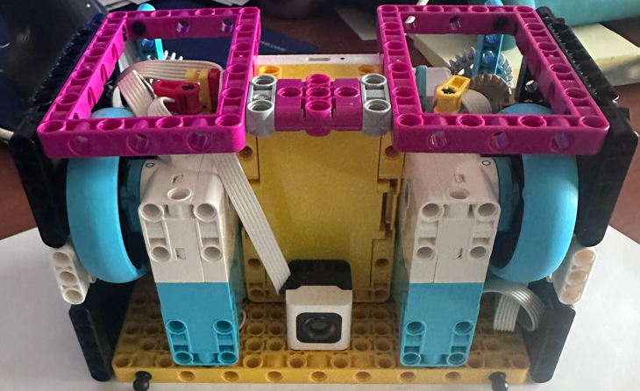
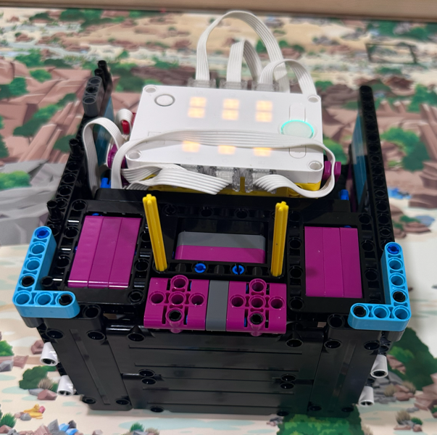
Iterate and learn
Notes:
Riona

Slide 12
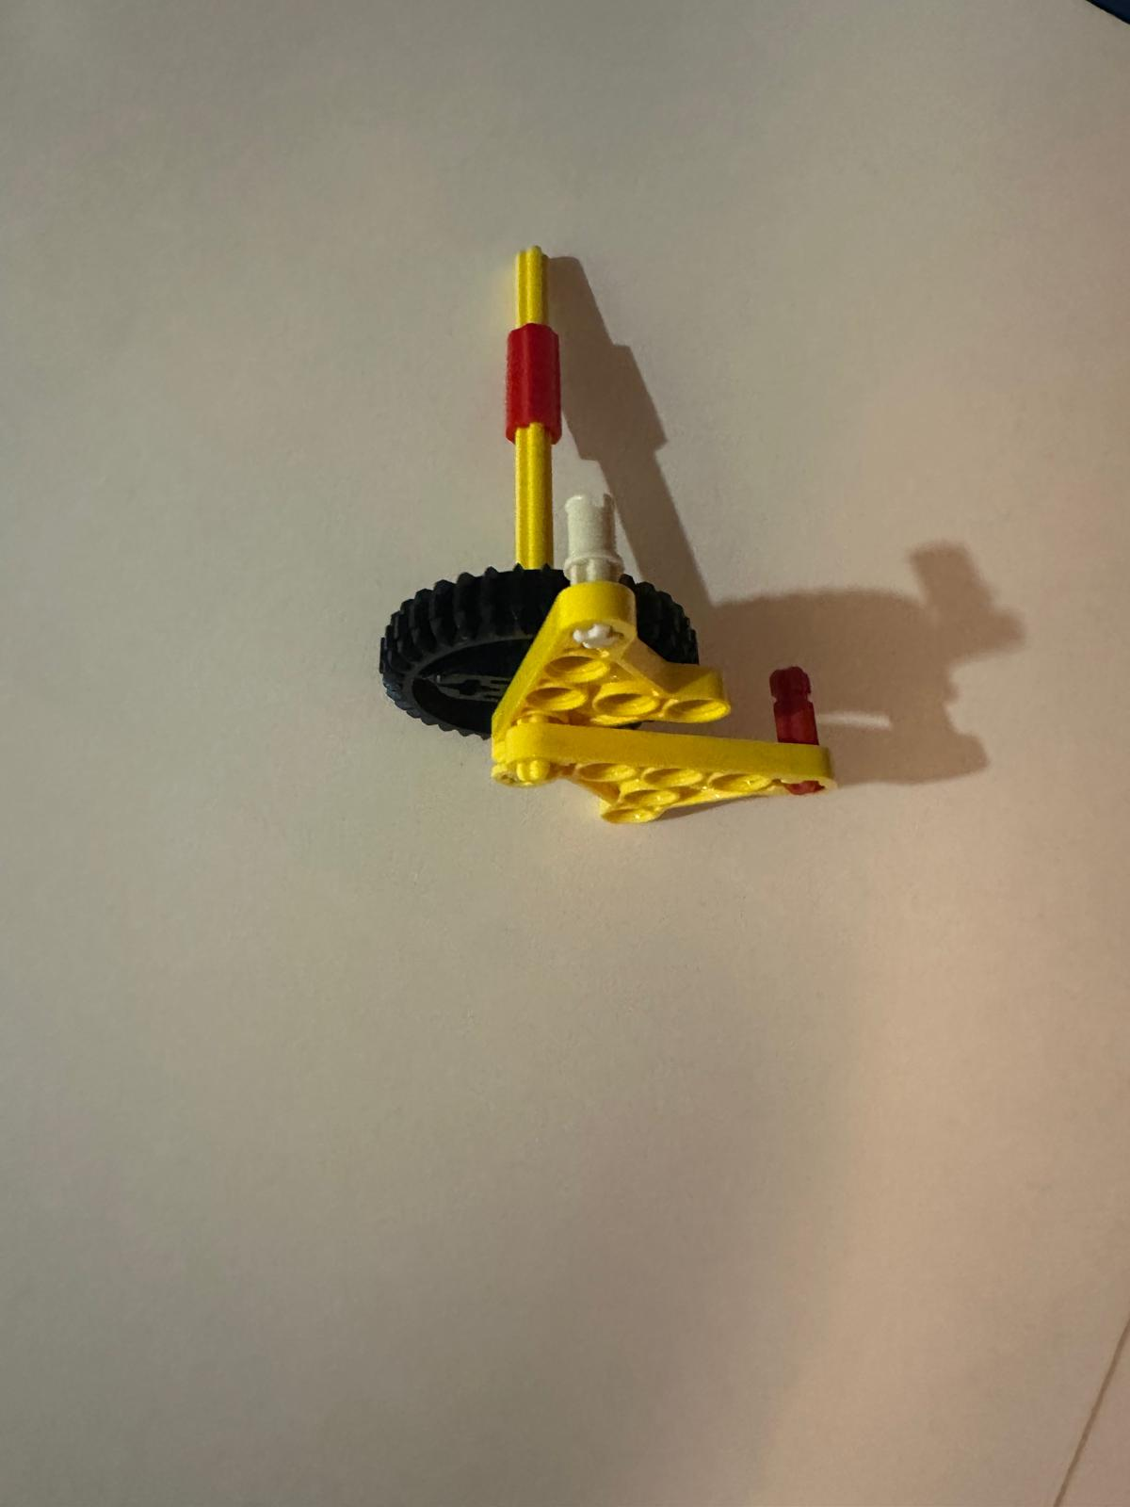
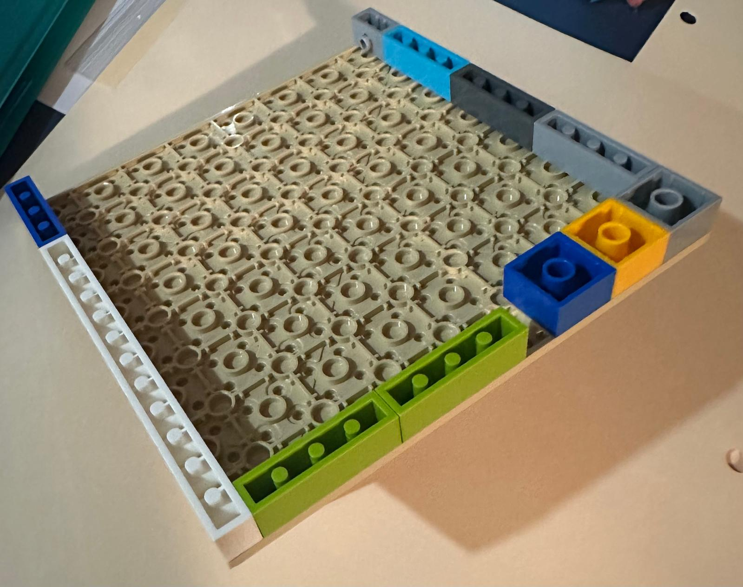
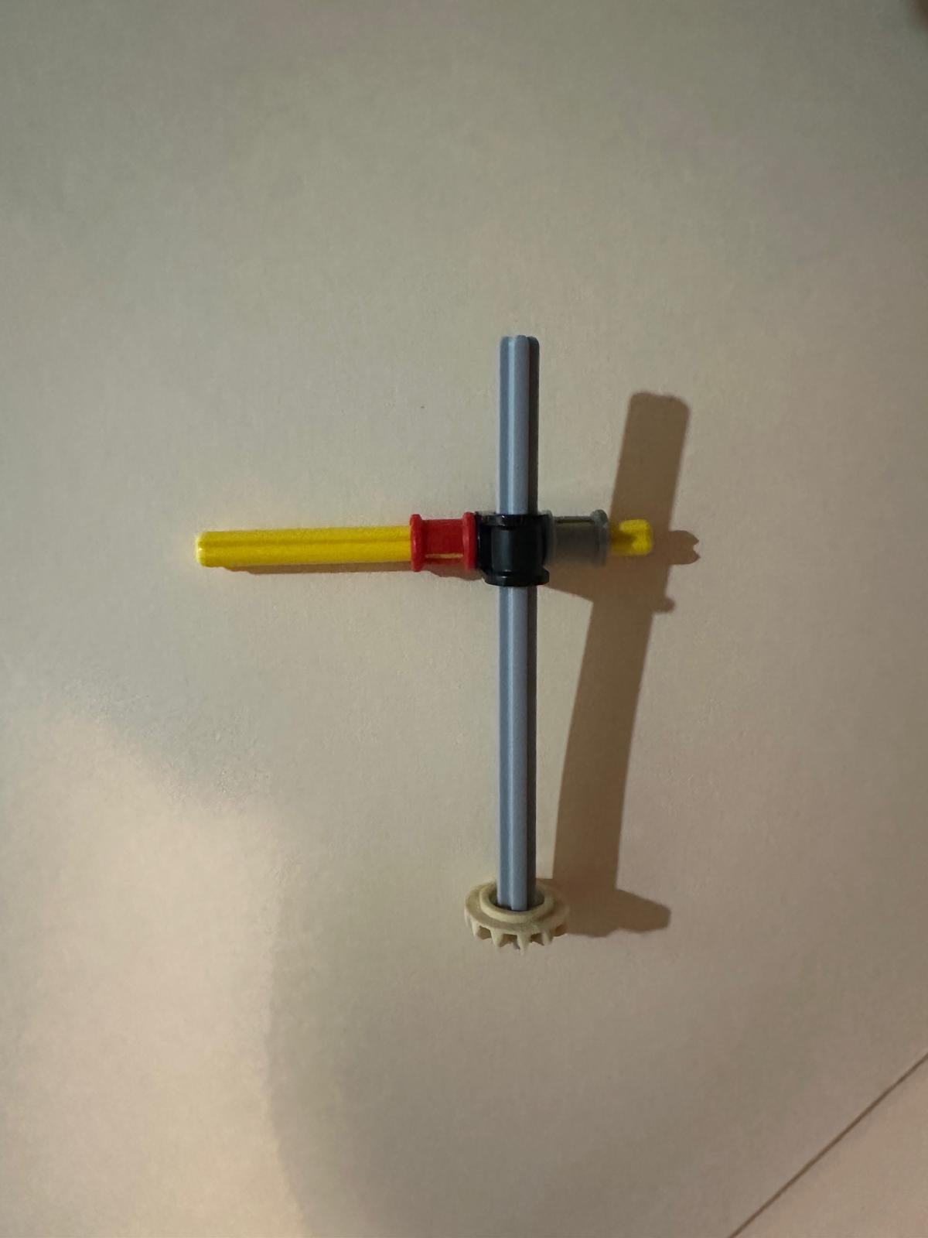
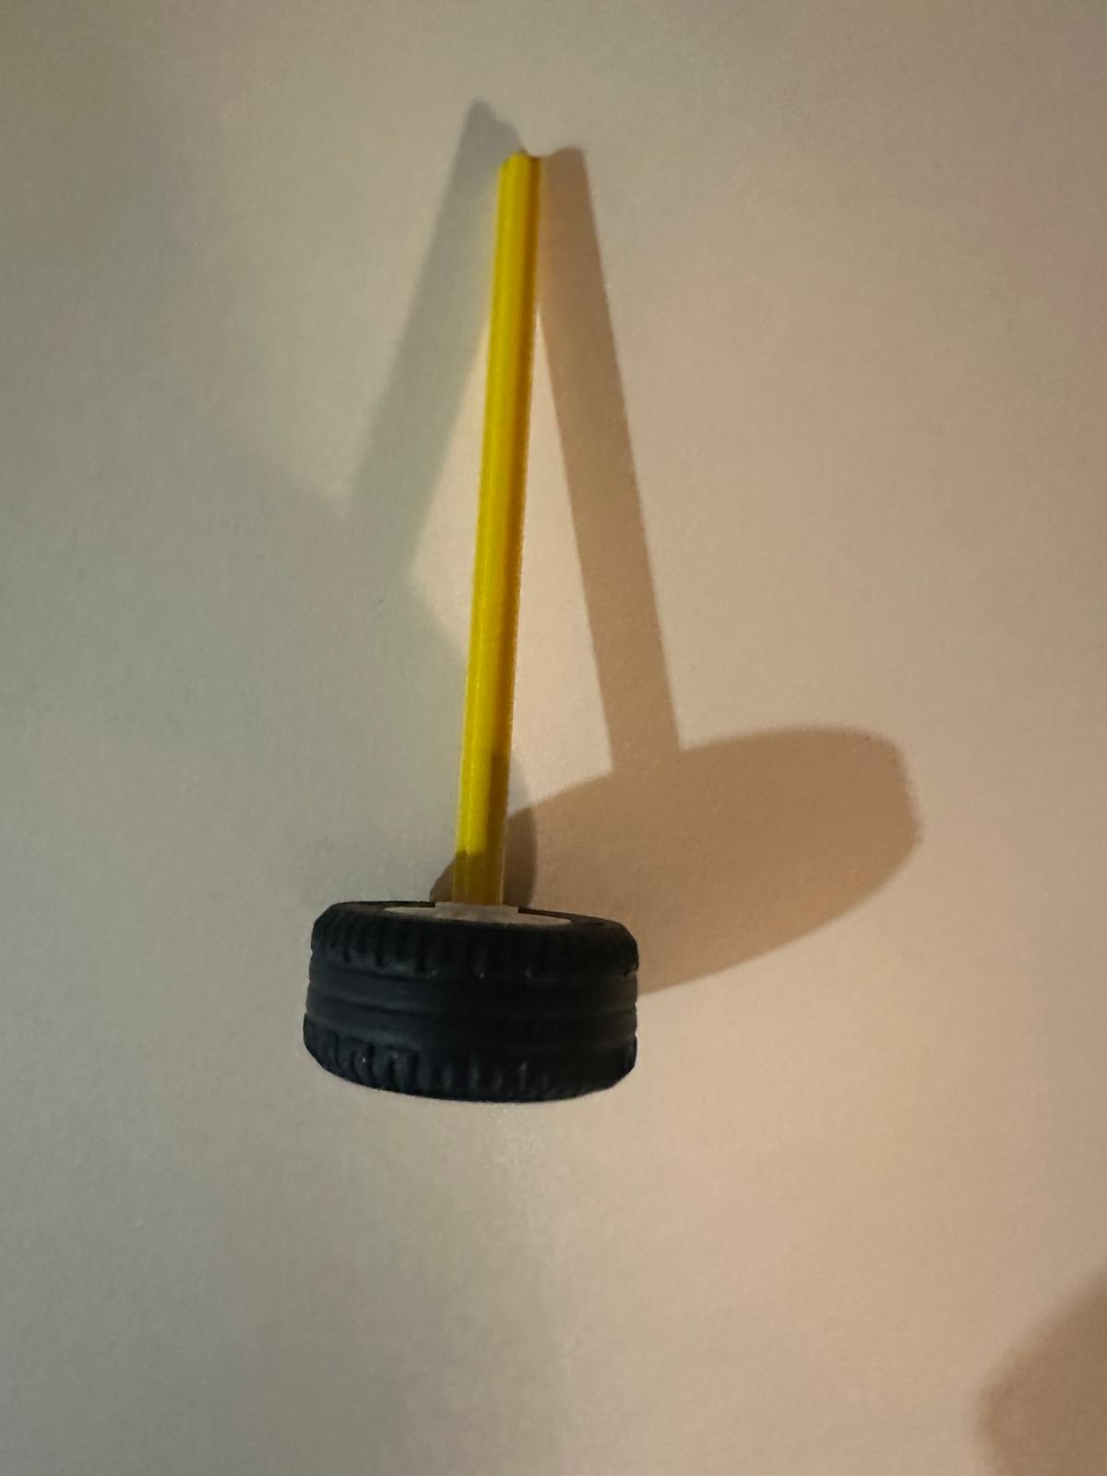
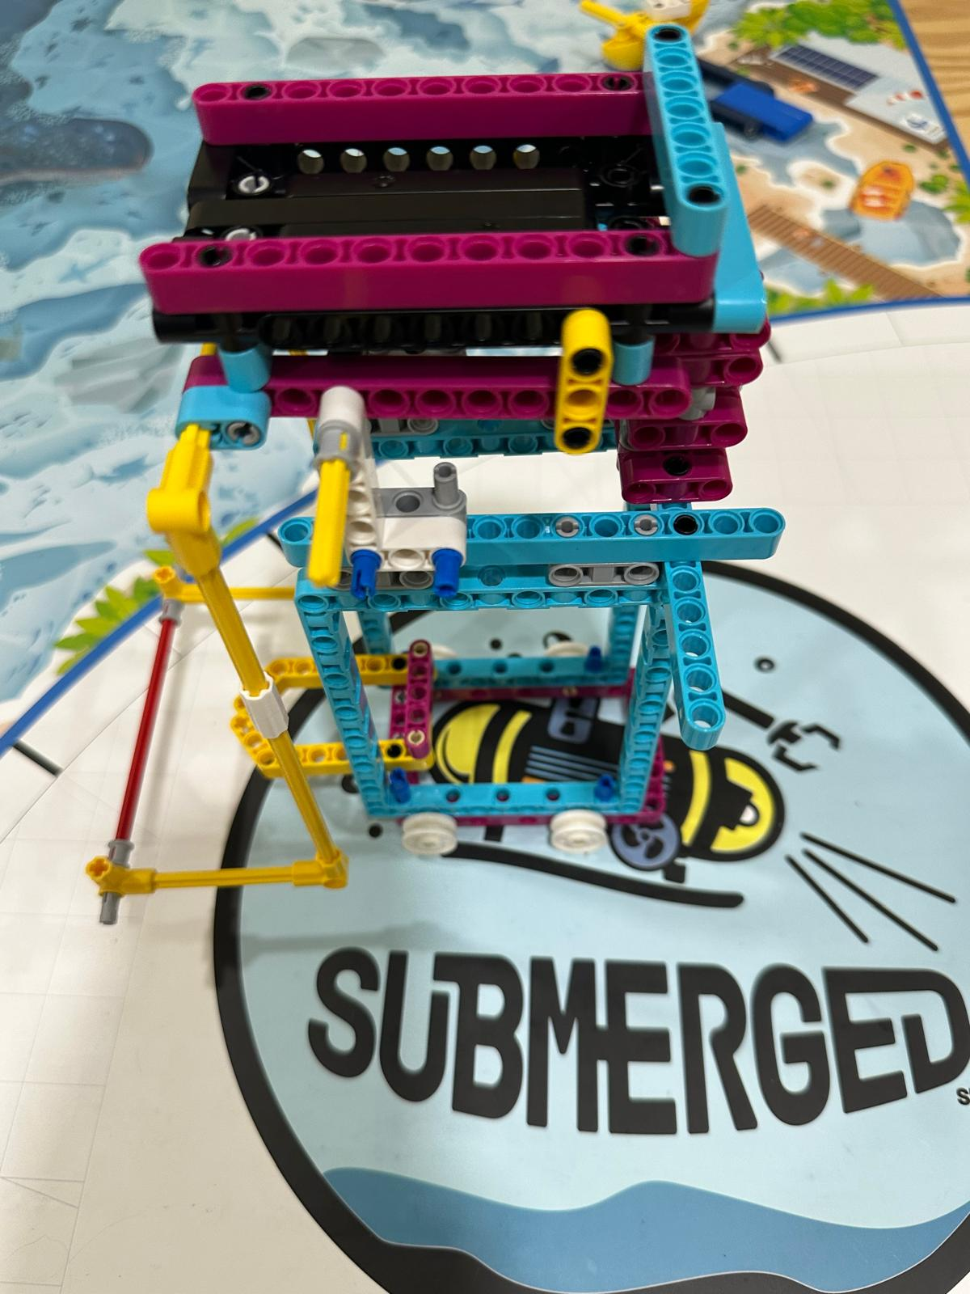
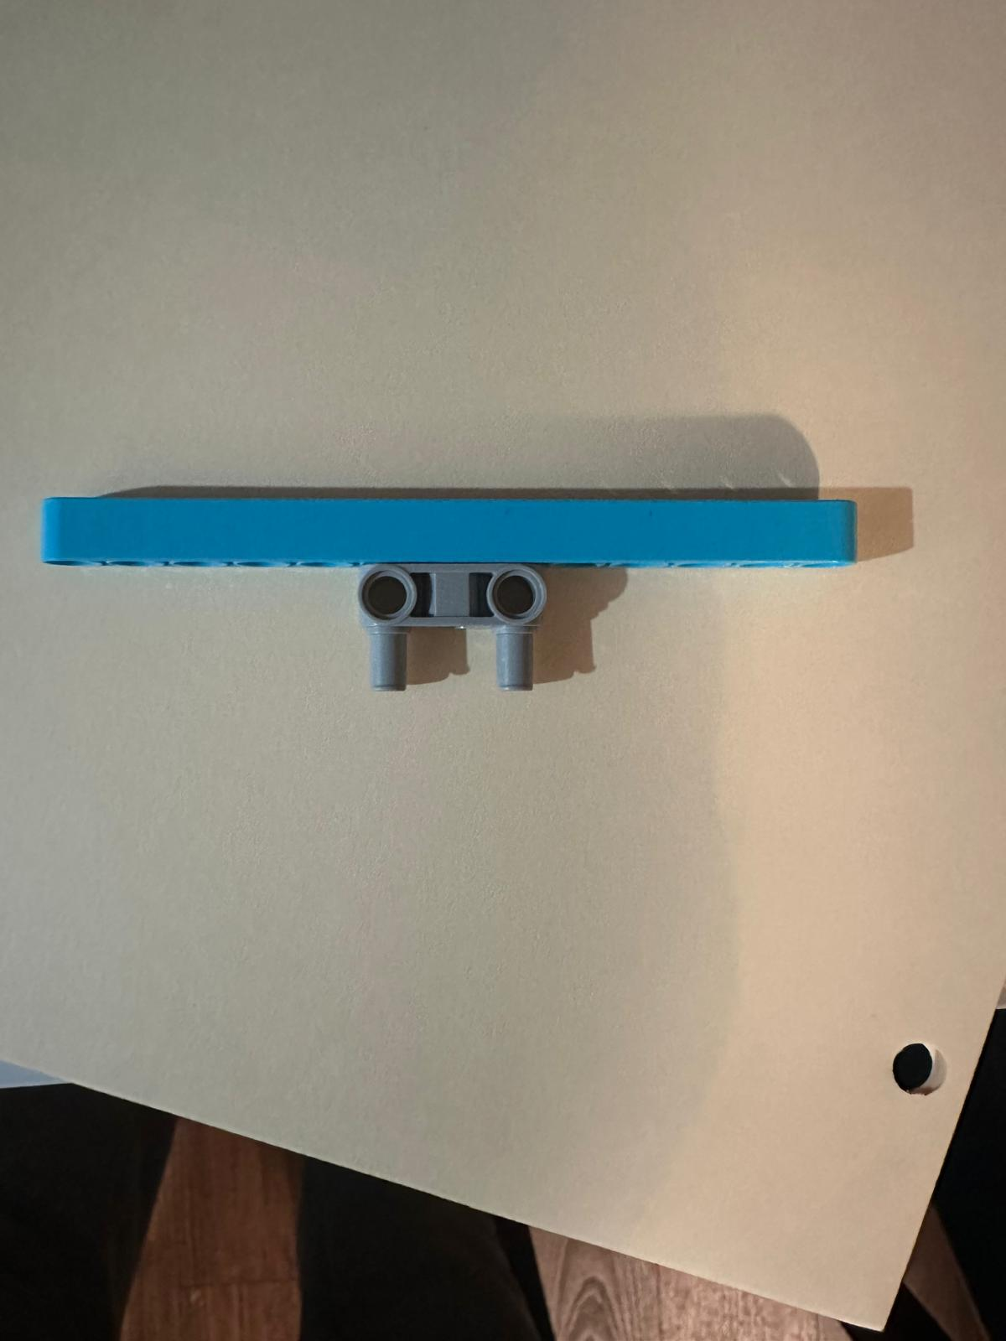
Used learning to Improve
It’s easy to add attachments on front and back of our compact little Bot Robot.
We also made several simple attachments for missions
Notes:
Riona

Slide 13
Share and Enjoy
We took turns and shared workload and experience.
Team had 7 girls and we became good friends and had lot of fun during break time.
We got better at programming and learned to use Gyro for more accurate movements.
At times robot did not work as programmed and broke models and seeing it fail was funny.
We had so much fun during field trip at Nelson Leges Quarry park.
We discovered new and creative ways to solve missions and really enjoyed it.
Notes:
Saumya

Slide 14
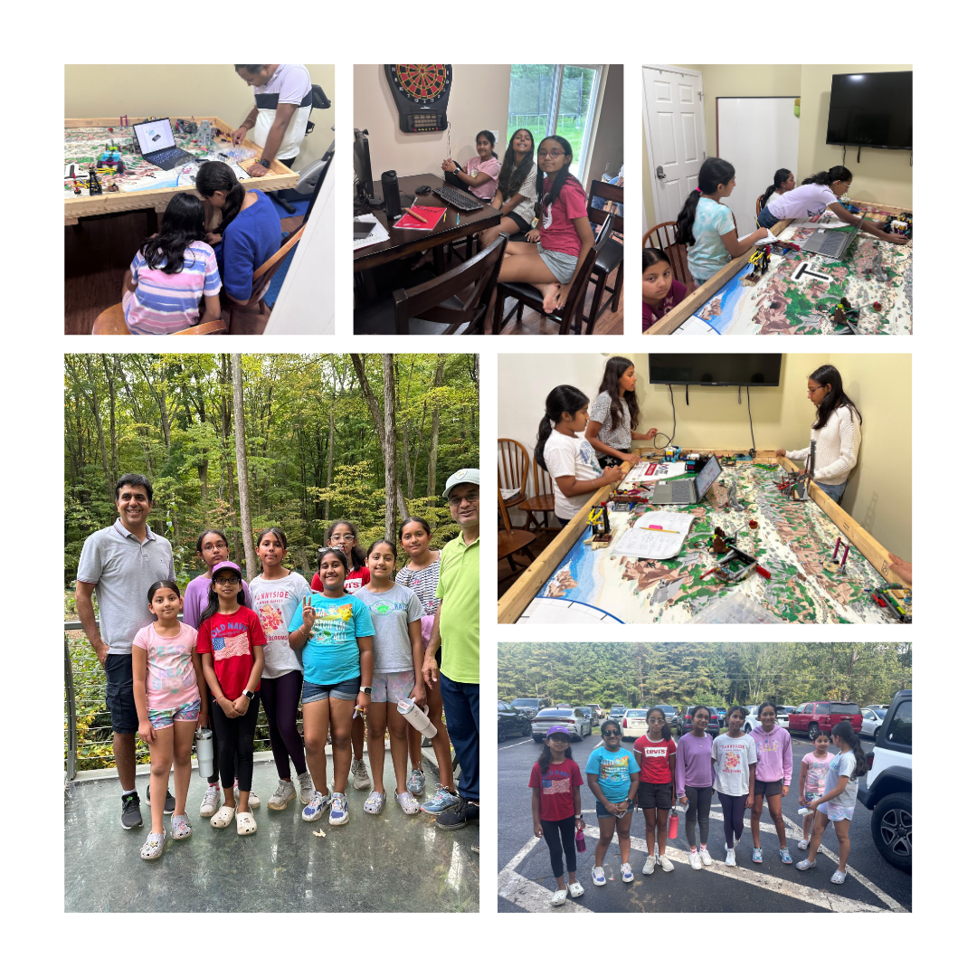
Notes:
Saumya
Here are some pictures we captured during our season with some fun moments

